Slide 1
Compiler FInal Project
Build the Mini-LISP interpreter
Demo : 2016/06/06(一) - 2016/06/22(三)

Slide 2
Mini-LISP
Prefix and Parenthesized
5 * 2 => (* 5 2)
2 + 3 + 4 => (+ (+ 2 3) 4) => (+ 2 3 4)
(5 − 6) × 7 => ( * ( - 5 6 ) 7)

Slide 3
Mini-LISP
print statement(boo,num)
(print-num 1) 1
(print-num ( + 2 3)) 5
(print-bool #f) #f
(print-bool (> 2 3)) #f

Slide 4
Mini-LISP
fun ( function)
(fun(x) (+ 1 x))
(fun() 1)
(print-num ((fun() 1))) 1
(print-num ((fun(x) (* x 2)) 2)) 4

Slide 5
Mini-LISP
if statement
(print-num (if (< 1 2)
(+ 1 2 3)
(* 1 2 3 4 5)))
(if (< 1 2)
(print-num (+ 2 3))
(* 1 2 3 4 5))
Error

Slide 6


Mini-LISP
define
(define x 1)
(define foo (fun (x) (+ x 1)))
1
2

Slide 7
Mini-LISP interpreter - Sample 1
example1.lsp
csmli (interpreter)
(+ 1 2 3 4 5)
15
$ ./csmli example1.lsp
$ 15

Slide 8
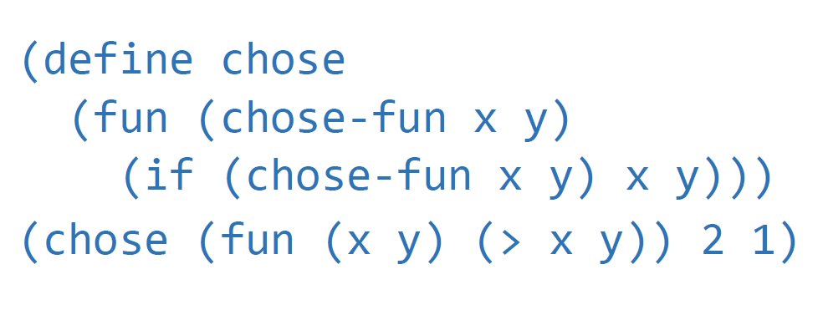
Mini-LISP interpreter - Sample 2
example2.lsp
$ ./smli example2.lsp
$ 2

Slide 9
Project Grade - Feature
Open test case (80%)
Your program
01_1.lsp
01_2.lsp
b1_1.lsp
Mini-Lisp
Hidden test case (20%)
Oracle
You can see me
csmli

Slide 10

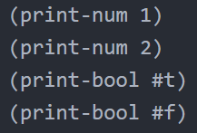
Project Grade - Basic Feature (100)
Syntax Error (10)
Print (10)
Syntax Error
1
2
#t
#f

Slide 11

Project Grade - Basic Feature (100)
Numerical Operations (25)
+, -, *, /, mod, >, <, =(equal)
2
-1

Slide 12
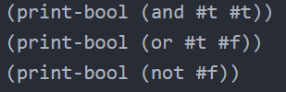
Project Grade - Basic Feature (100)
Logical Operations (25)
and, or, not
#t
#t
#t

Slide 13
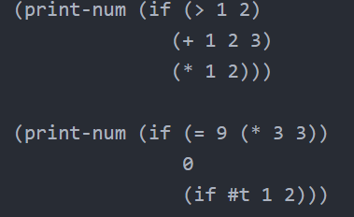
Project Grade - Basic Feature (100)
if Expression (8)
2
0

Slide 14
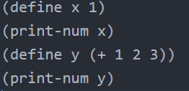
Project Grade - Basic Feature (100)
Variable Definition (8)
1
6

Slide 15

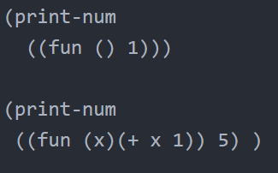

Project Grade - Basic Feature (100)
Function (8)
1
6

Slide 16
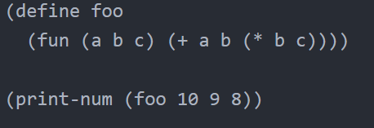
Project Grade - Basic Feature (100)
Named Function (6)
91

Slide 17
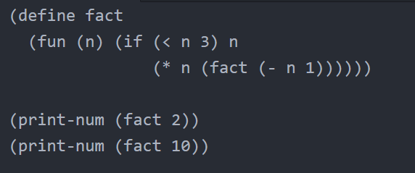
Project Grade - Bouns Feature (20)
Recursion (5)
2
3628800

Slide 18

Project Grade - Bouns Feature (20)
Type Checking (5)
Type Error

Slide 19
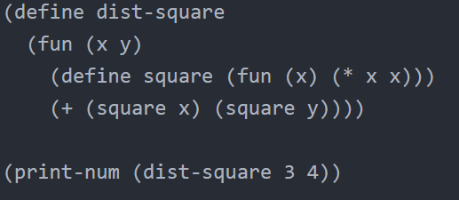
Project Grade - Bouns Feature (20)
Nested Function (5)
25

Slide 20
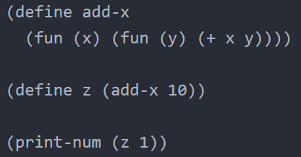
Project Grade - Bouns Feature (20)
First-class Function (5)
10

Slide 21
Project Grade - Bouns Feature (20)
First-class Function - (process)
(define add-x (fun (x) (fun (y) (+ x y))))
(define z (add-x 10))
(print-num (z 1))
Process
(print-num (z 1))
(z 1) => ((add-x 10) 1)
((add-x 10) 1) => ((fun (y) (+ 10 y)) 1)
11 (x = 10, y = 1)

Slide 22
Project Grade - Bouns Feature (20)
First-class Function - (process)
(define foo (fun (f x) (f x)))
(print-num (foo (fun (x) (- x 1)) 10))
Process
Pass the ((fun(x) (-x 1)) 10) to f as parameter
pass the (fun(x) (-x 1)) as f
pass the 10 as x paramter
(print-num (foo (fun (x) (- x 1)) 10))
(fun (f x) (f x)) : call f and pass x to f

Slide 23
Requirements
Only C / C++, Java ,lex, yacc
Use the grammar and regular expression in Mini-Lisp Spec
Use the test_data.zip to get open test case

Slide 24
Finally
You must read the SPEC before start programming
Demo time : 2016/06/06(一) - 2016/06/22(三)
If you have the problems, please tell us as soon as possible because maybe there is wrong in final project
Don’t cheat TA and Boss

Slide 25
Q&A

